Slide 1
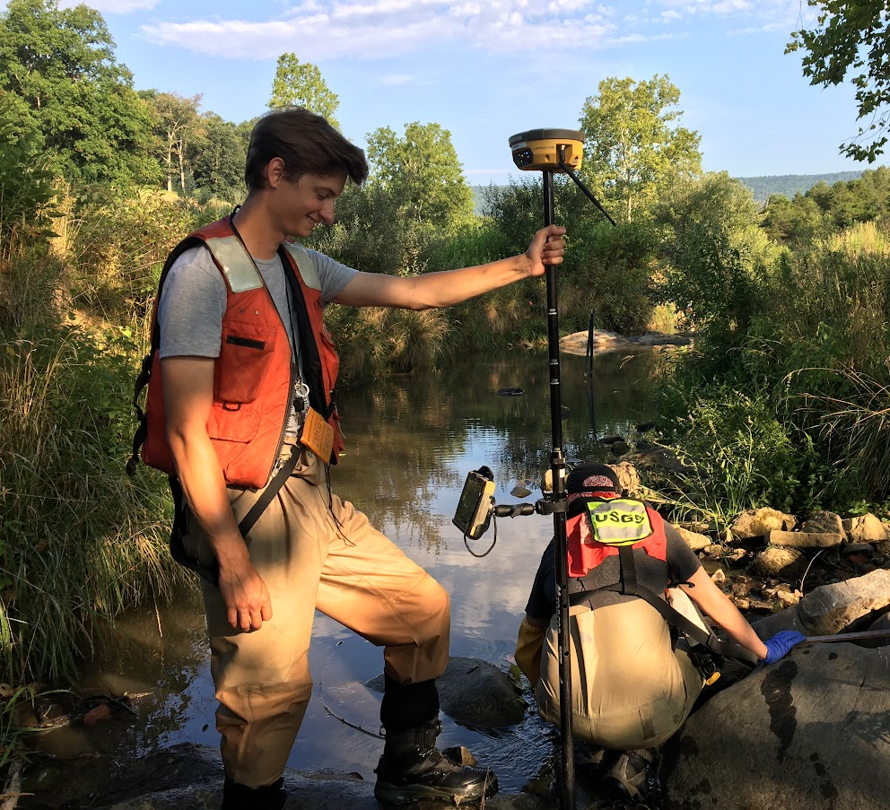
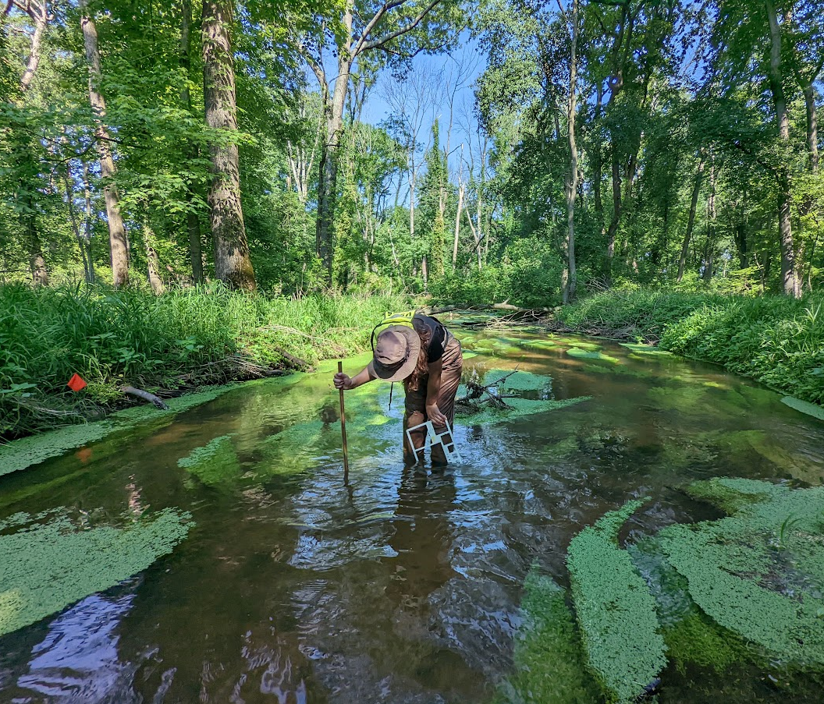
US Geological Survey
MD-DC-DE Water Science Center

Slide 2
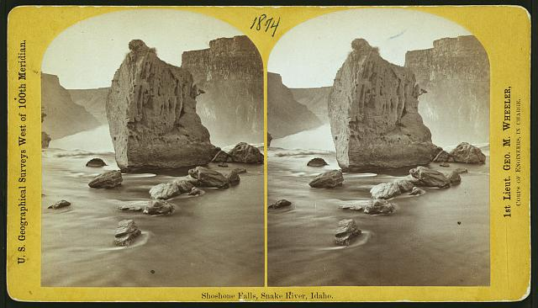
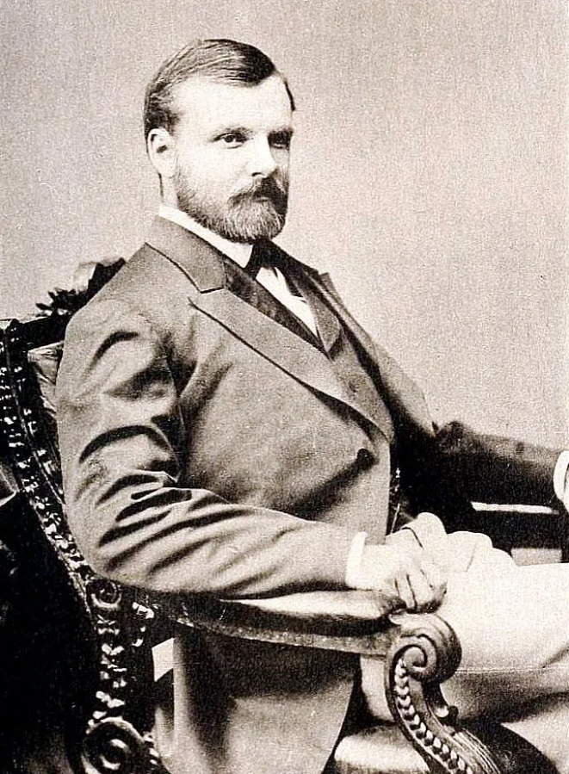
Our Story
The US Geological Survey is tasked with taking stock of public lands and their resources in 1879
As a research agency, we provide information on and study:
Topography
Water resources
Biological resources
Geological and mineral resources
Image credit:
(inset): https://pubs.usgs.gov/circ/c1050/fig09.jpg
(background) https://www.loc.gov/rr/print/coll/western_survey/list7.html
Notes:
The Survey was carved out under the Department of the Interior in 1879 after the National Academy of Sciences noted that much of the land added to the United States in the 19th century would need to be catalogued and inventoried. Of course we got right to work, and by 1884 we started producing topographic maps for much of the country under the direction of our first Director Clarence King, shown here on the right.
Now topographic surveys aren’t all that we do, among plenty of other things we also monitor the ~400 thousand miles of streams in the U.S. with about 11,000 streamgages as of the last time I checked. We are also the sole purely scientific agency under the Department of the Interior, meaning we aren’t responsible for any regulations of public resources. Instead we act as a neutral party available to the public, and frequently work for and with local governments and corporations to help provide unbiased, impartial answers to scientific problems they’re facing. Sort of like a publicly funded consulting agency. And because so much of the environmental field is cross-disciplinary, we have everyone from biologists to geologists to chemists to hydrologists to paleontologists vulcanologists to astronomers.

Slide 3
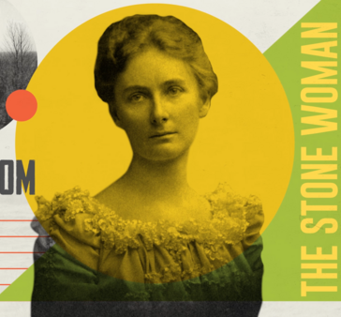
Dr. Florence Bascom
2nd woman to earn a PhD in geology in the US, 1st ever at JHU
First woman to work at the USGS
Foundational to understanding the complex geologies of the East Coast of the US
Florence Bascom Geoscience Center in Reston, VA is her namesake
Image Credit: https://www.usgs.gov/media/videos/biography-florence-bascom
Notes:
Mentored a ton of future woman geologists and paleontologists including Julia Gardner, who our state fossil is named after (collected at Calvert Cliffs, it’s a cool mollusk that you shouldn’t try to pronounce)

Slide 4
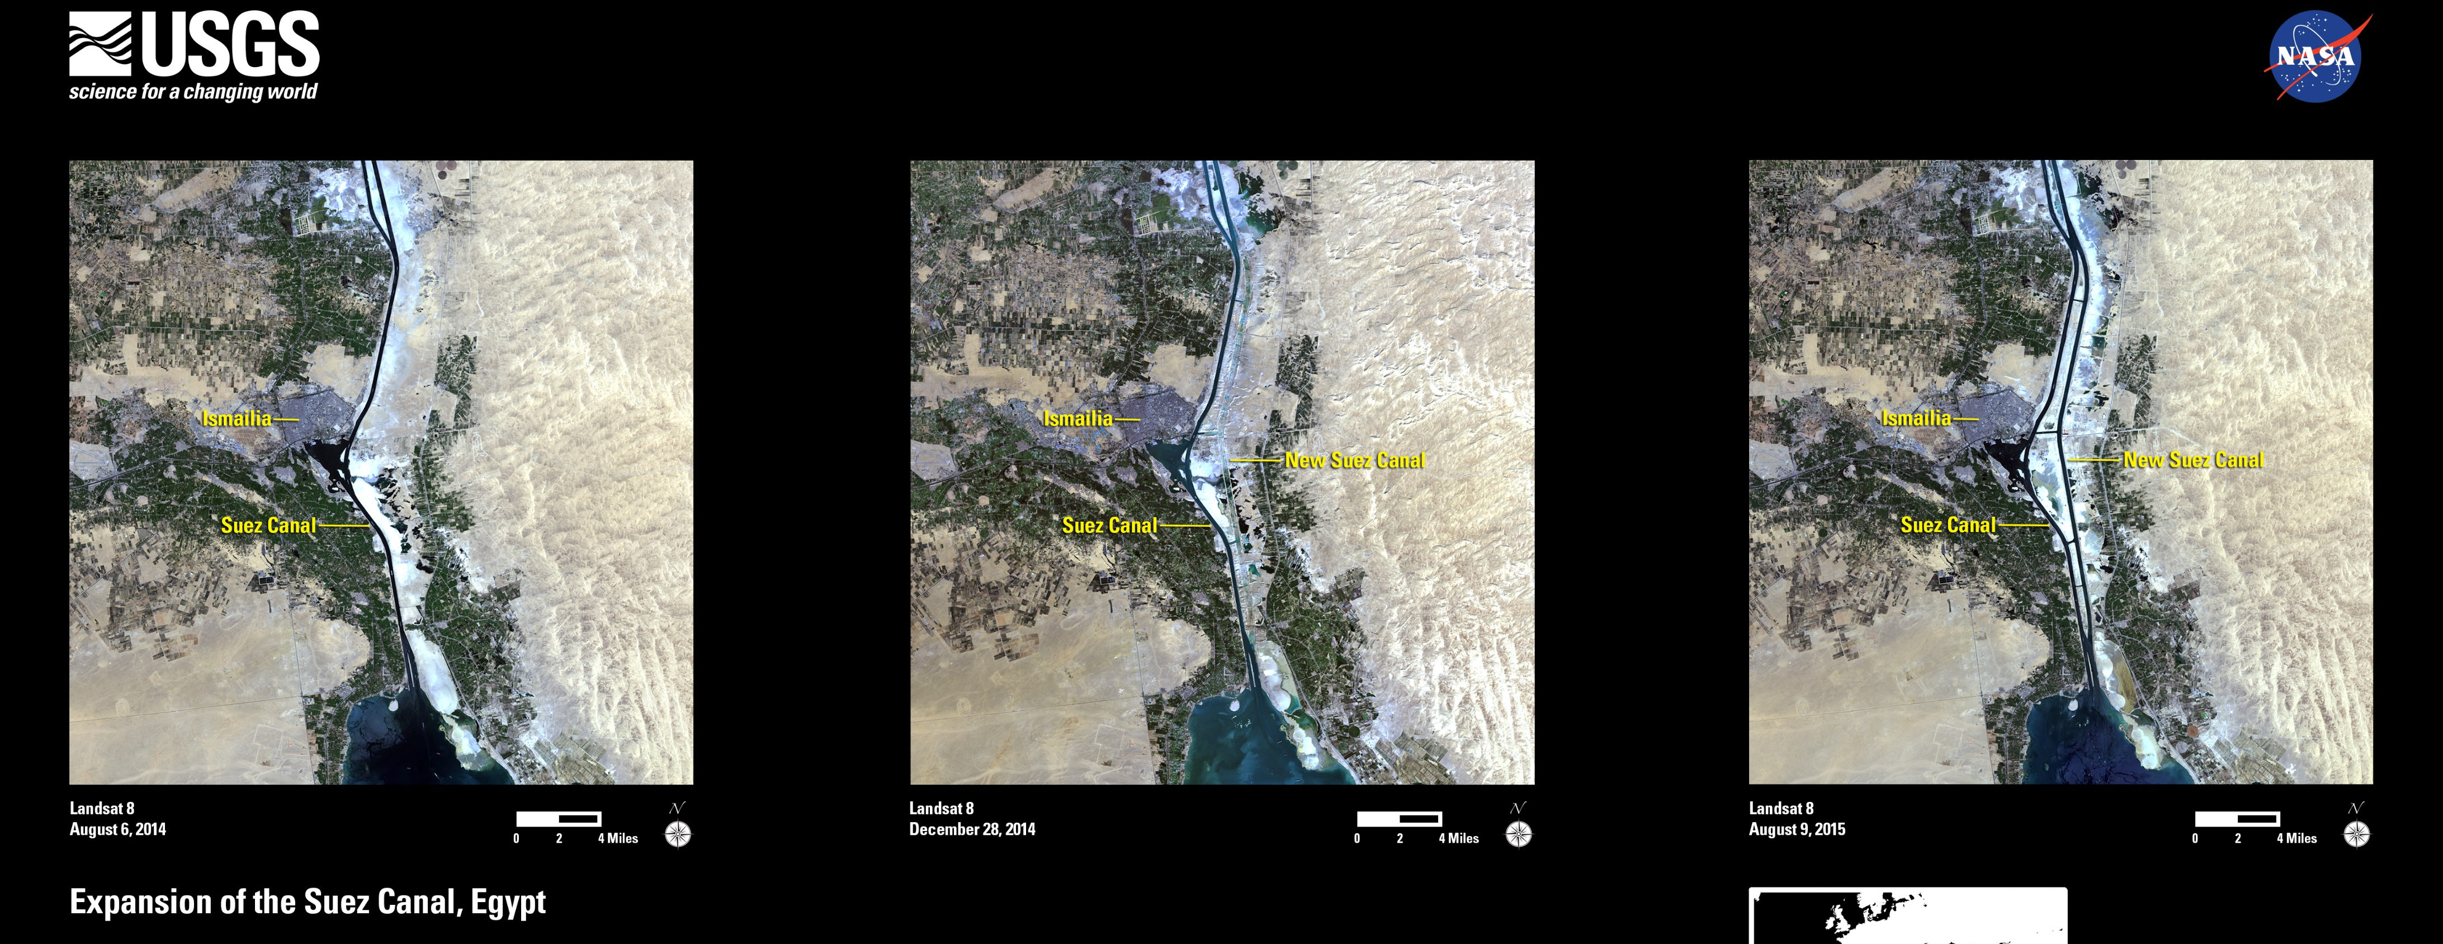
USGS Work Abroad
Volcanic studies in the Kingdom of Hawaii (pre-annexation), continues to provide volcano assistance before and during disasters like 1991 Mt. Pinatubo
Geological and hydrological support for proposed Panama Canal routes
WWII: creating water resource and topographic maps for the Allies
Helped Saudi Arabia and Pakistan establish their own Geologic Surveys
Monitors for nuclear weapons testing and earthquakes through the Global Seismic Network
Maps the globe with Landsat satellites along with NASA, helps the UN monitor World Heritage Sites
Has research, equipment sharing, and reciprocal visit agreements with scientists for dozens of countries
Image Credit: https://eros.usgs.gov/media-gallery/image-of-the-week/expansion-of-the-suez-canal-egypt
Notes:
Sources for future Zach: https://nap.nationalacademies.org/read/13302/chapter/12#134

Slide 5
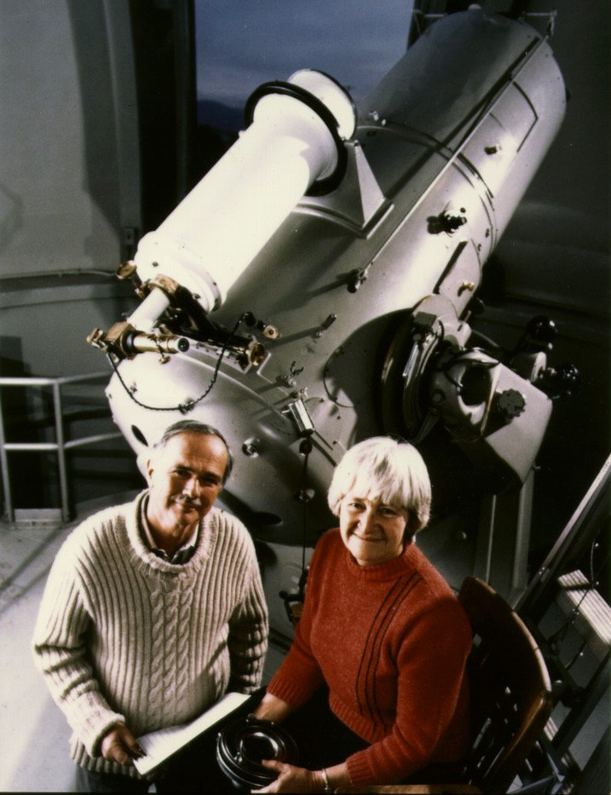
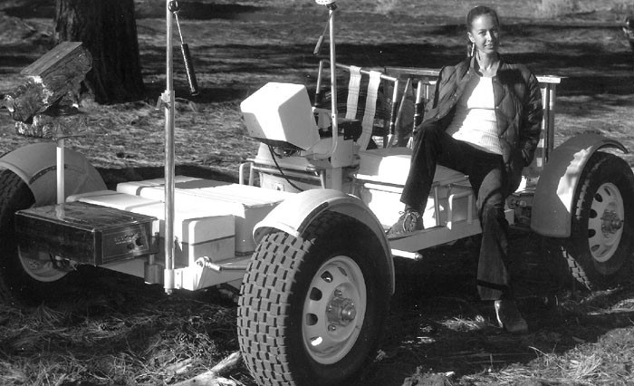
Astrogeology Research
Drs. Eugene and Carolyn Shoemaker
Discovered the Comet Shoemaker-Levy 9 that crashed into Jupiter in 1994
Eugene was set to be the first geologist to walk on the Moon
Dr. Baerbel Lucchitta
Designed lunar maps for the Apollo 11 mission
Studied ice geology on Mars, Europa, the Moon, and Antarctica
Image Credit: (left): https://astrogeology.usgs.gov/About/People/GeneShoemaker/ (right): https://www.usgs.gov/media/images/dr-baerbel-lucchitta-during-apollo-days
Notes:
Shoemaker has a crater in Australia named after him, along with the Near Earth Asteroid Rendezous probe that landed on an asteroid in 2000, and an asteroid, and a Finnish metal song. His ashes are on the moon as well. Carolyn became a planetary astronomer officially at 51, she discovered 32 comets (a record at the time) and >500 asteroids, she has a crater on Mars named after her. Baerbel (berbel) is the only person I’ve ever seen that has both a glacier and a minor planet named after themselves.

Slide 6
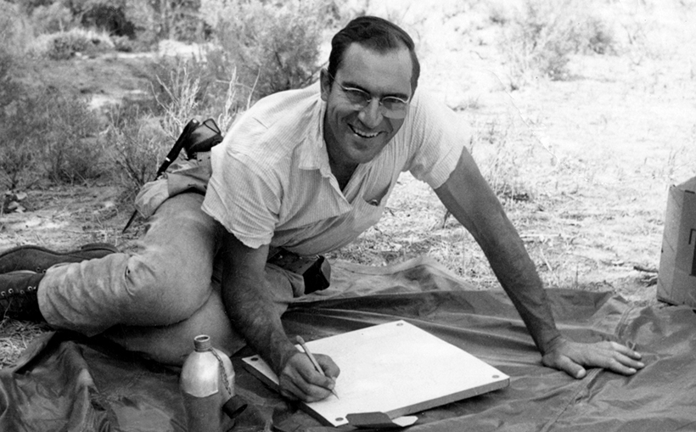
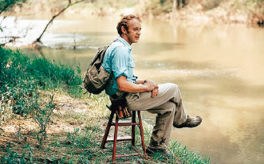
Luna Leopold & Reds Wolman
Cowrote the book on Fluvial Geomorphology
Dr. Leopold argued for a holistic approach to water management that incorporated the environment + political + socioeconomic factors
Dr. Wolman invented the Wolman Pebble Count and headed the Chesapeake Bay’s Oyster Roundtable that started cleaning up the Bay in the 1990s
Notes:
Their book is Fluvial Processes in Geomorphology

Slide 7
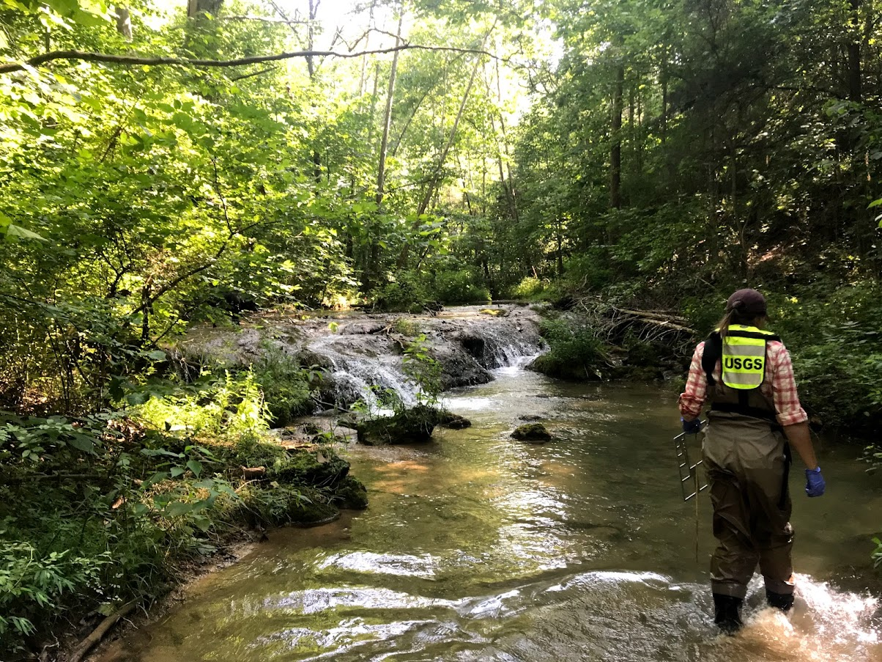
The MD-DC-DE Water Science Center
Core Sciences
Ecosystems
Energy and Minerals
Natural Hazards
Water Resources
One of ~60 Science Centers
Research Goals:
Minimize loss of life and property from natural disasters
Manage water, biological, energy, and mineral resources
Enhance and protect the quality of life
Contribute to wise economic and physical development

Slide 8
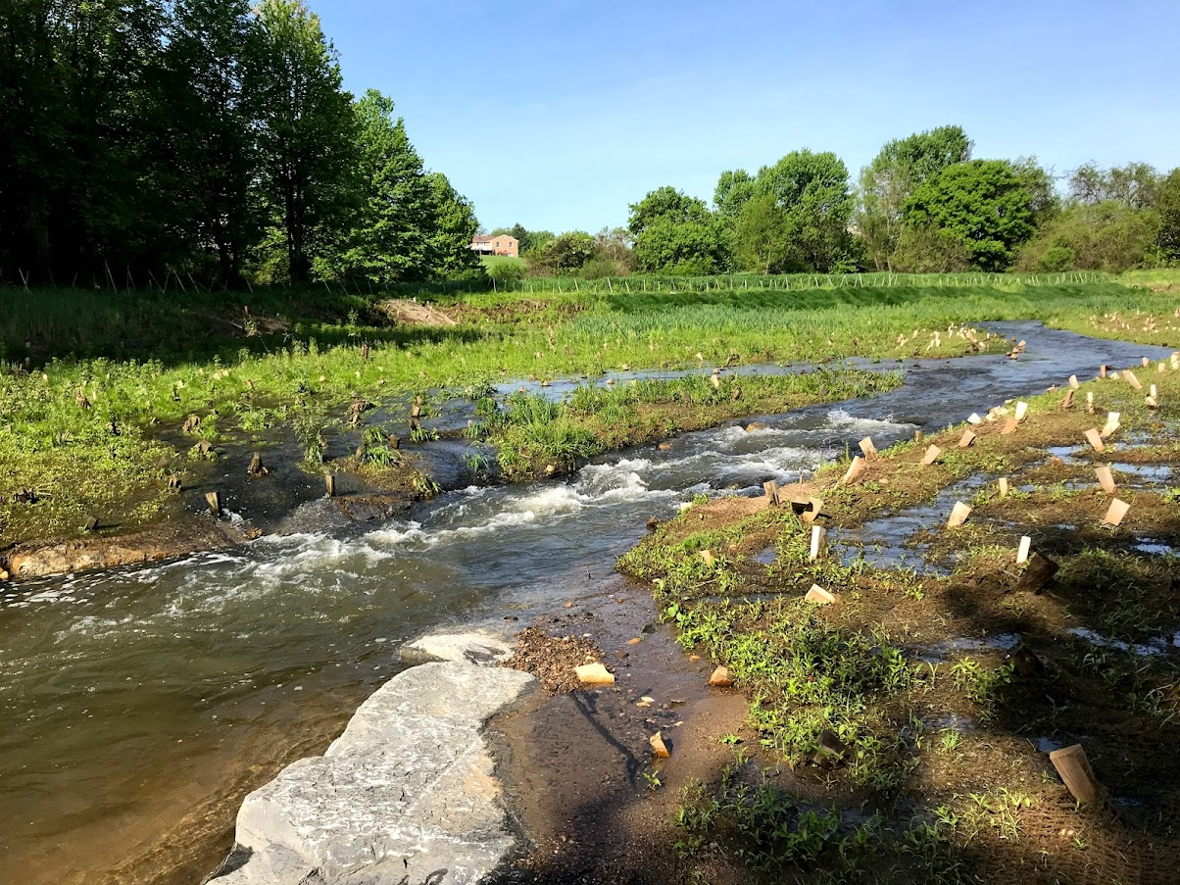
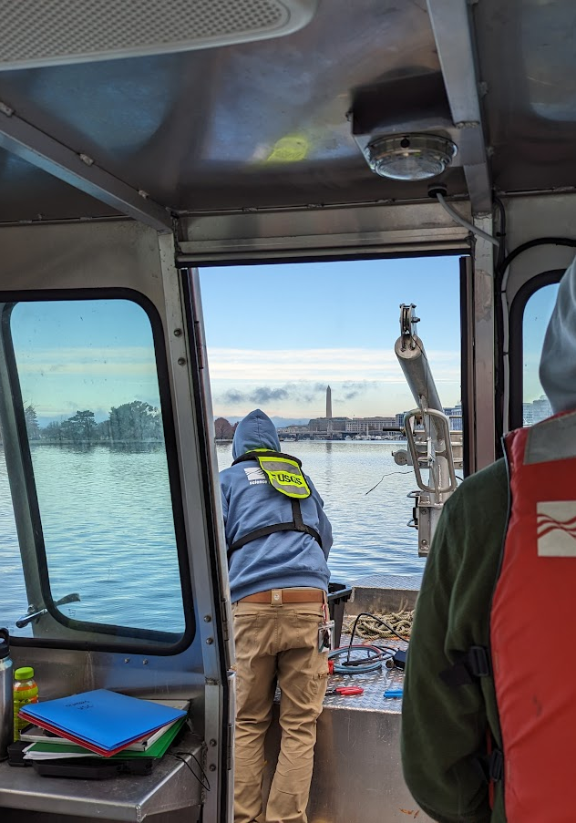
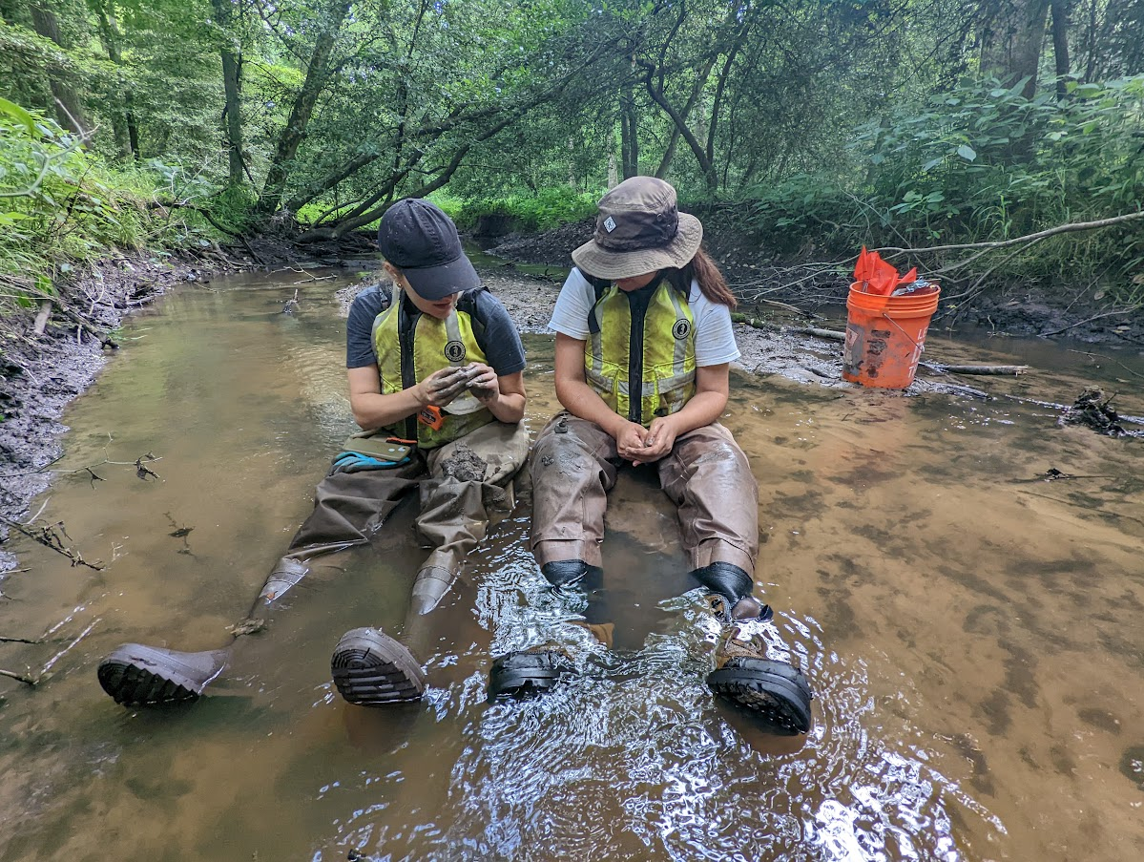
The MD-DC-DE Water Science Center
Monitoring a stream restoration near Frederick, MD
Sampling for PCBs and PAHs in the Washington Ship Channel, Washington D.C.
Employs about 85 staff members, including:
Research scientists
Hydro-technicians and field assistants
Administrative and budgeting staff
IT/Data management
Monitors dozens of streamgages across DC, Delaware, and Maryland
PLUS:
Groundwater wells
Fate and bioremediation of contaminants
Harmful algal blooms
Sediments and geomorphology
Data wrangling
Surveying channel and floodplain morphology, southern Delaware

Slide 9
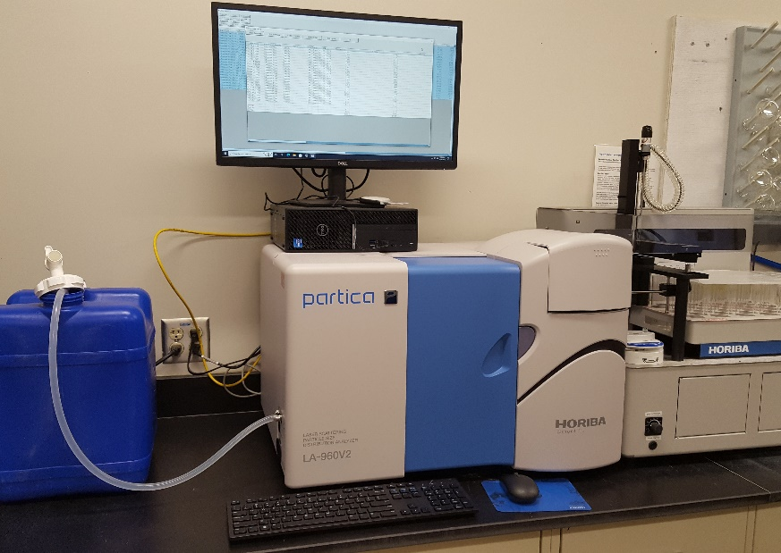
Gadgets & Gizmos
Laser-Diffraction Particle Size Analyzers
Gas Chromatograph with a triple Quadrupole Mass Spectrometer and electron capture detector
Another GC outfitted with a Flame Ionization Detector and Chemical ionization mass spectrometer
Ion Chromatograph
Custom Anaerobic Chamber
Muffle Furnaces, Freeze-dryers, fume hoods, incubators, microscopes
So many augers
USS Pertinacious (our sampling boat)
A drone sampling boat (unnamed for now)
Image Credit: Jason Chase

Slide 10
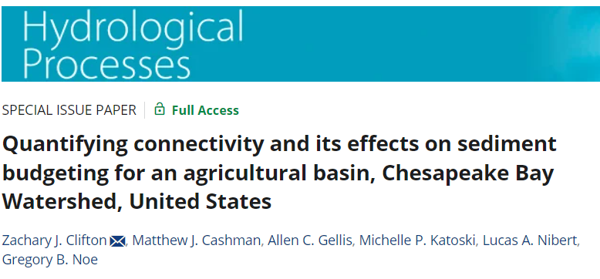
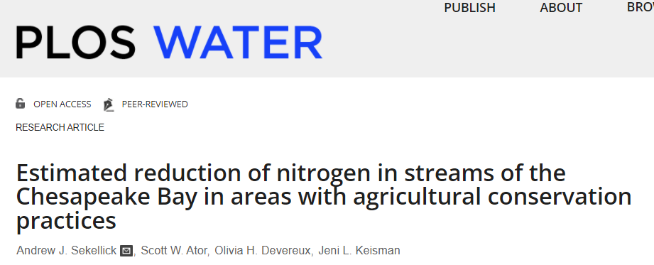
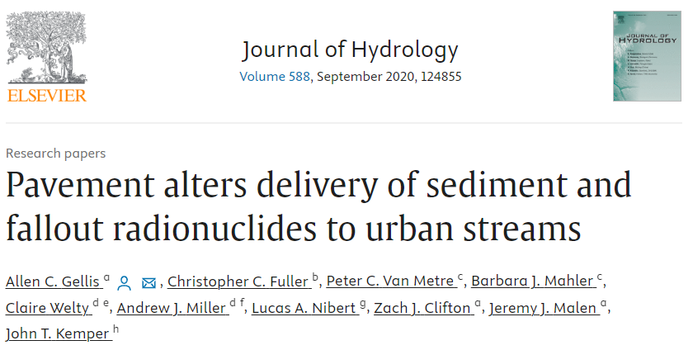

Slide 11
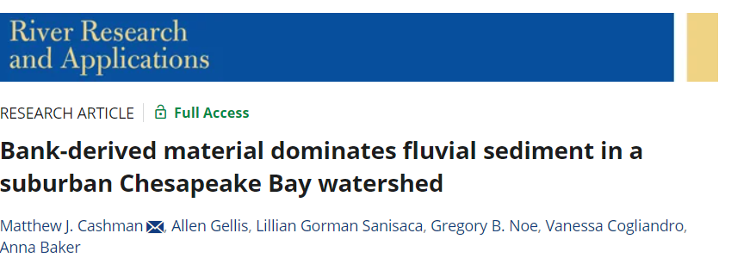
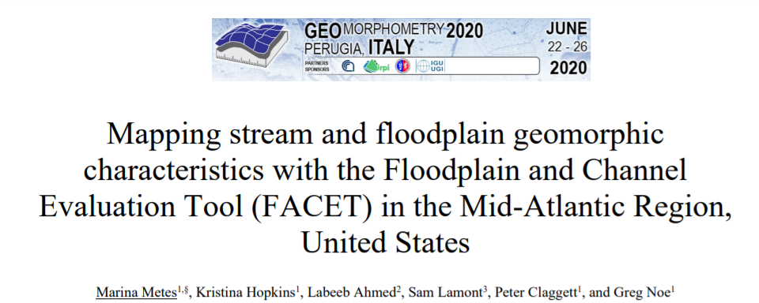
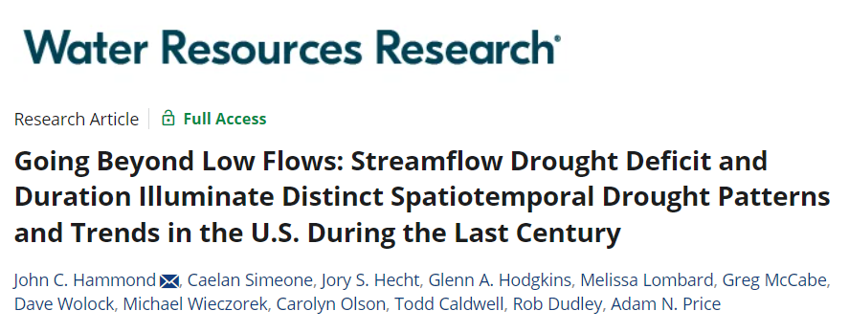
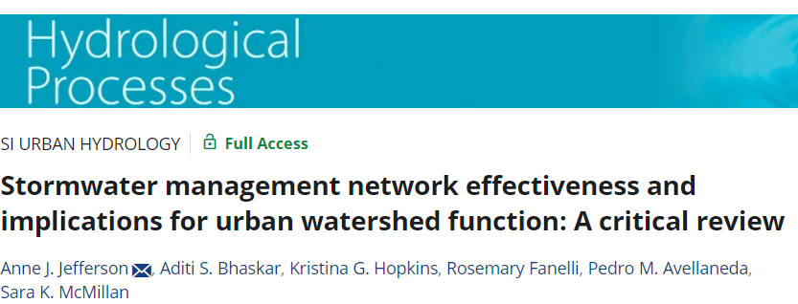
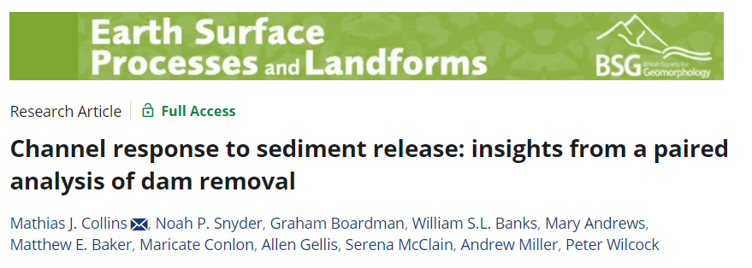

Slide 12
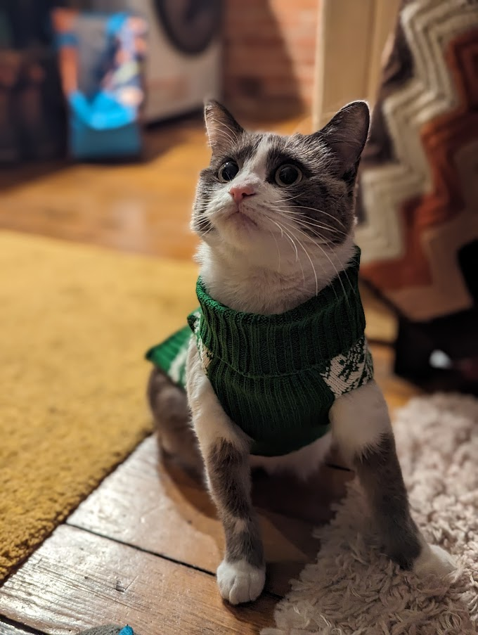
Questions?

